Slide 1


Sales Analytics Dashboard
An Executive Implementation Blueprint & Technical Roadmap from Data ETL to Predictive Intelligence
9,994 Orders $2.30M Revenue $286.4K Profit

Slide 2
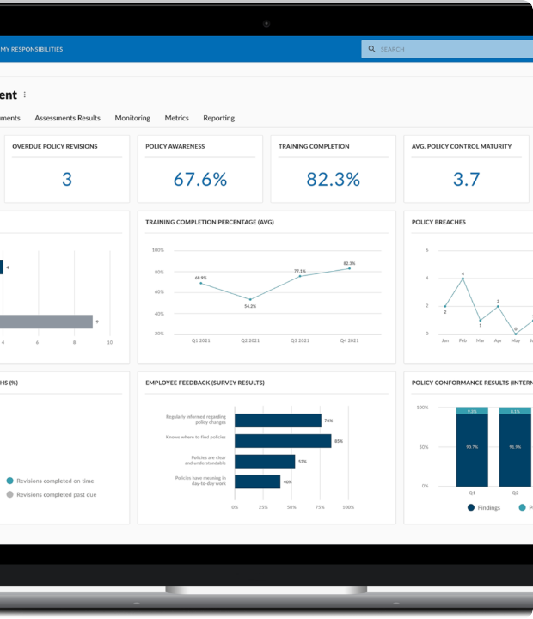

Executive Introduction
Strategic Scope & Objectives
This project synthesizes 9,994 transactional records across 49 U.S. states to evaluate company-wide revenue drivers, regional growth opportunities, and profit vulnerabilities.

Slide 3







End-to-End Analytics Roadmap
Step 1: Data ETL
Step 2: DAX & Measures
Step 3: Visual Dashboards
Step 4: Insights & ML
Ingest Excel source dataset into Power Query. Enforce proper data types, clean missing postal codes, and establish DAX Date Table schema.
Develop centralized measures library including Total Sales ($2.30M), Total Profit ($286.4K), Avg Discount (15.5%), Margin %, and YoY logic.
Construct 3 dedicated interactive visual layouts for Exploratory Data Analysis (EDA), Performance Comparisons, and Predictive Trends.
Deploy machine learning models for customer churn forecasting (>180 days risk), RFM K-Means clustering, and executive reporting.

Slide 4

Stakeholder Requirement Analysis
User Persona | Core Objectives & Requirements | Primary Dashboard Visuals
Executive Leadership | Macro-level performance, top-line profit tracking, and strategic margin risk management. | KPI Summary Cards, YoY Line Charts, Executive Highlights
Regional Sales Managers | Territory benchmarking, state revenue share, and local category opportunities. | Regional Donut Share, State Maps, Category Bar Charts
Supply Chain & Logistics | Fulfillment efficiency, ship mode distribution, and Q4 stocking preparations. | Ship Mode Treemap, Delivery Timelines, Volume Forecasts
Pricing & Margin Analysts | Discount sensitivity, profit leakage isolation, and discount rule enforcement. | Scatter Sensitivity Plot, AI Key Influencers Visual

Slide 5


Data Architecture & DAX Measures
Star Schema Data Pipeline
Centralized DAX Library
Data was cleansed via Power Query by casting currency fields (`Sales`, `Profit`) to decimal, applying `Text.Trim` to categorical values, and creating a continuous 1-to-Many `Calendar` dimension table for DAX time-intelligence operations.
Core formulas include `Total Sales = SUM(Orders[Sales])`, `Total Profit = SUM(Orders[Profit])`, `Margin % = DIVIDE([Total Profit], [Total Sales])`, and `Last Year Sales = CALCULATE([Total Sales], SAMEPERIODLASTYEAR('Calendar'[Date]))`.

Slide 6
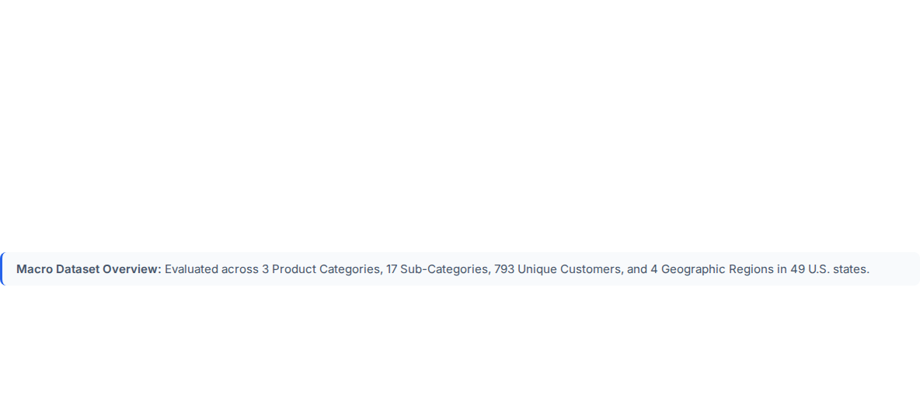




Executive Key Performance Metrics
9,994
$2.30M
$286.4K
15.5%
TOTAL ORDERS
GROSS REVENUE
NET PROFIT
AVG DISCOUNT RATE

Slide 7
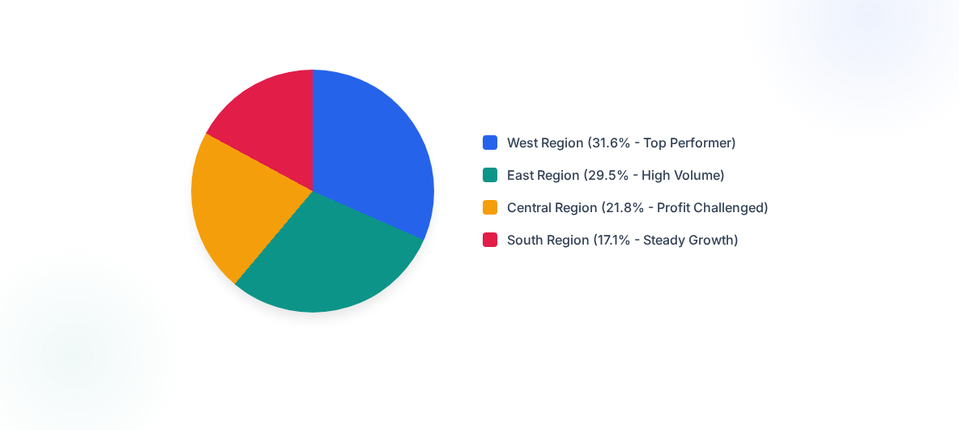
Regional Revenue Distribution

Slide 8
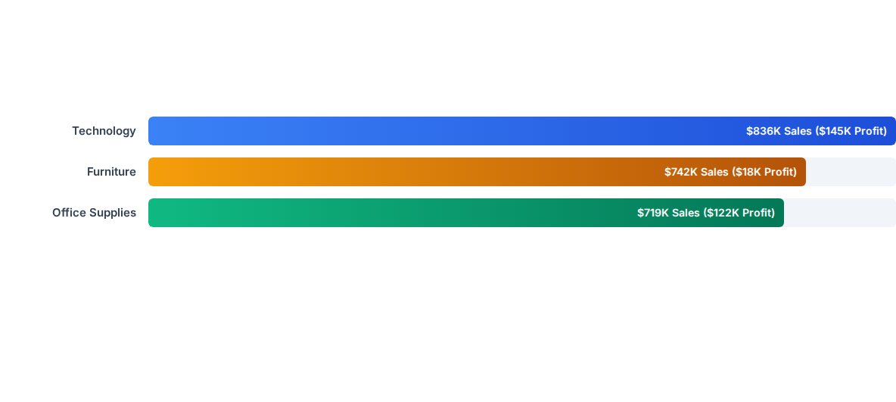
Category Revenue & Profit Disparity

Slide 9
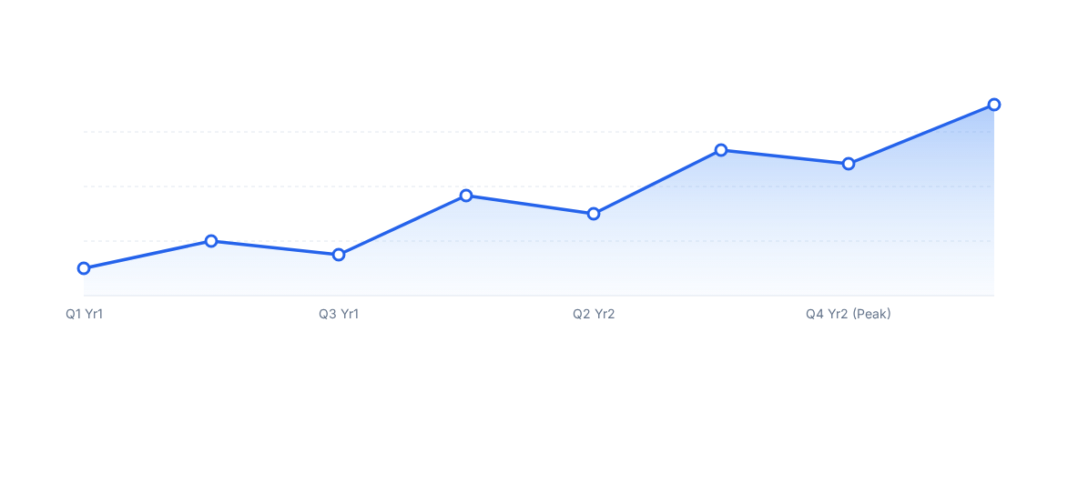
Quarterly Revenue Trends & Seasonality

Slide 10



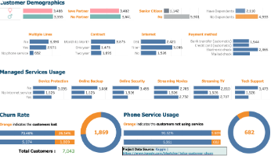
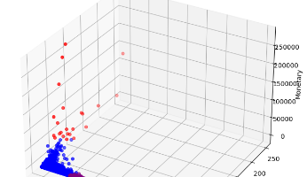
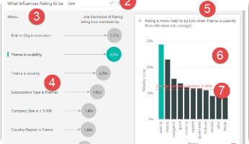
Advanced Predictive Machine Learning
1. Churn Prediction
2. RFM Segmentation
3. Anomaly Detection
Logistic Regression model analyzing purchase recency and frequency to flag high-risk customers before inactivity exceeds 180 days.
K-Means Clustering on Recency, Frequency, and Monetary scores dividing accounts into Champions, Loyal, and At-Risk groups.
Power BI AI Key Influencers pinpointing sudden profit drop root causes and isolating outlier discount spikes across states.

Slide 11
Actionable Business Strategies
Optimize Discount Guardrails: Eliminate discounts >20% on Furniture (Tables & Bookcases) to immediately stop net profit erosion and recover $20K+ in lost margins.
Q4 Inventory Pre-Stocking: Align supplier logistics schedules by mid-August to prepare warehouse inventories for the recurring 35% seasonal demand surge in Q4.
Focus on High-Margin Categories: Prioritize bundled promotional campaigns around Technology items (Copiers, Phones) to maximize profit dollars per order sold.
Territory Reallocation: Shift marketing capital from profit-challenged Central regions toward top-performing West (31.6% revenue) and East (29.5% revenue) markets.

Slide 12

Project Completed
Interactive Power BI Workbook, Executive Word Report & Slide Deck finalized.

Slide 13




Image Sources
https://corporater.com/wp-content/uploads/2021/07/kpis-dashboards-and-analytics-software-1o.png
Source: corporater.com
https://blog.coupler.io/app/uploads/2024/06/5-telco-customer-churn.png
Source: blog.coupler.io
https://miro.medium.com/v2/resize:fit:1332/0*721Y6139tgQUtzxY
Source: medium.com
https://learn.microsoft.com/en-us/power-bi/visuals/media/power-bi-visualization-influencers/power-bi-ki-numbers-new.png
Source: learn.microsoft.com

